Slide 1


IBM DATA SCIENCE CAPSTONE PROJECT
Space X Falcon 9 Landing Analysis
Ethan Benavides

Slide 2
OUTLINE 01 Executive Summary 02 Introduction 03 Methodology 04 Results 05 Conclusions

Slide 3
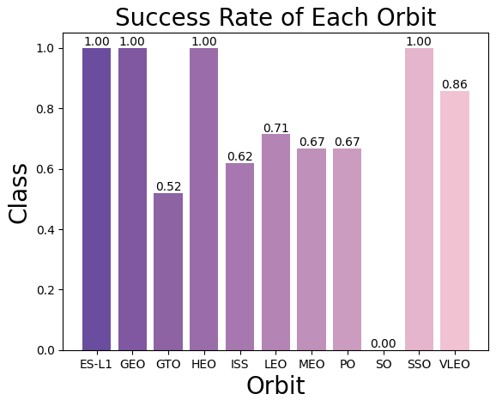
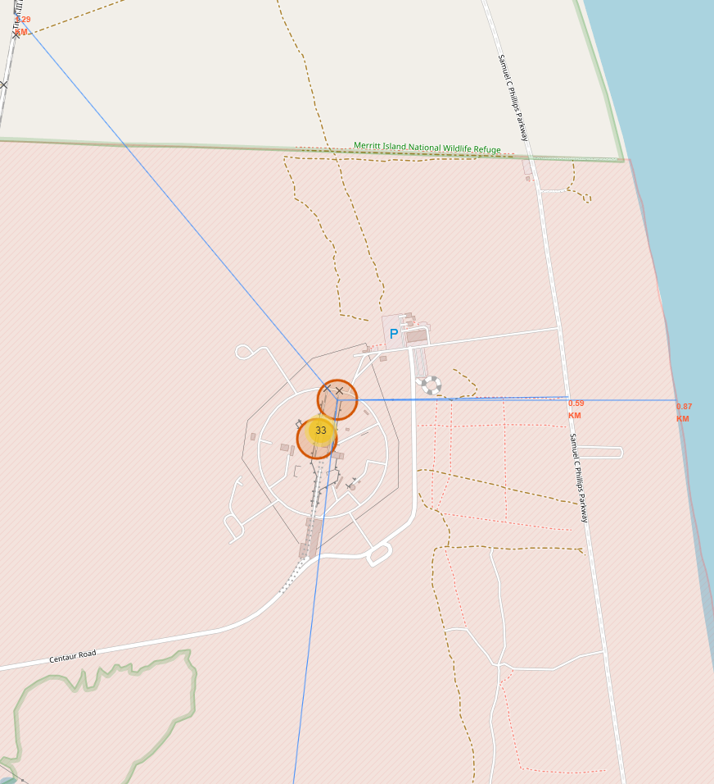
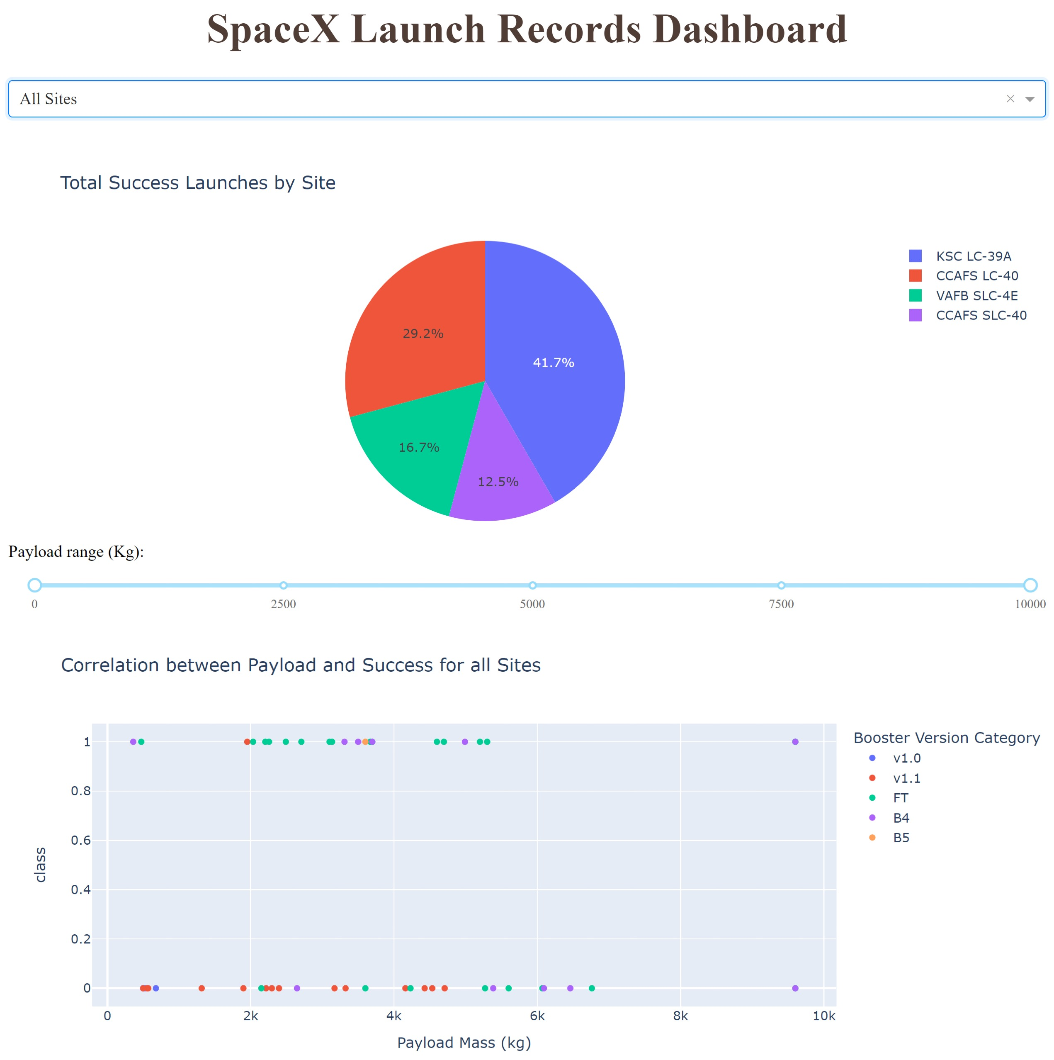
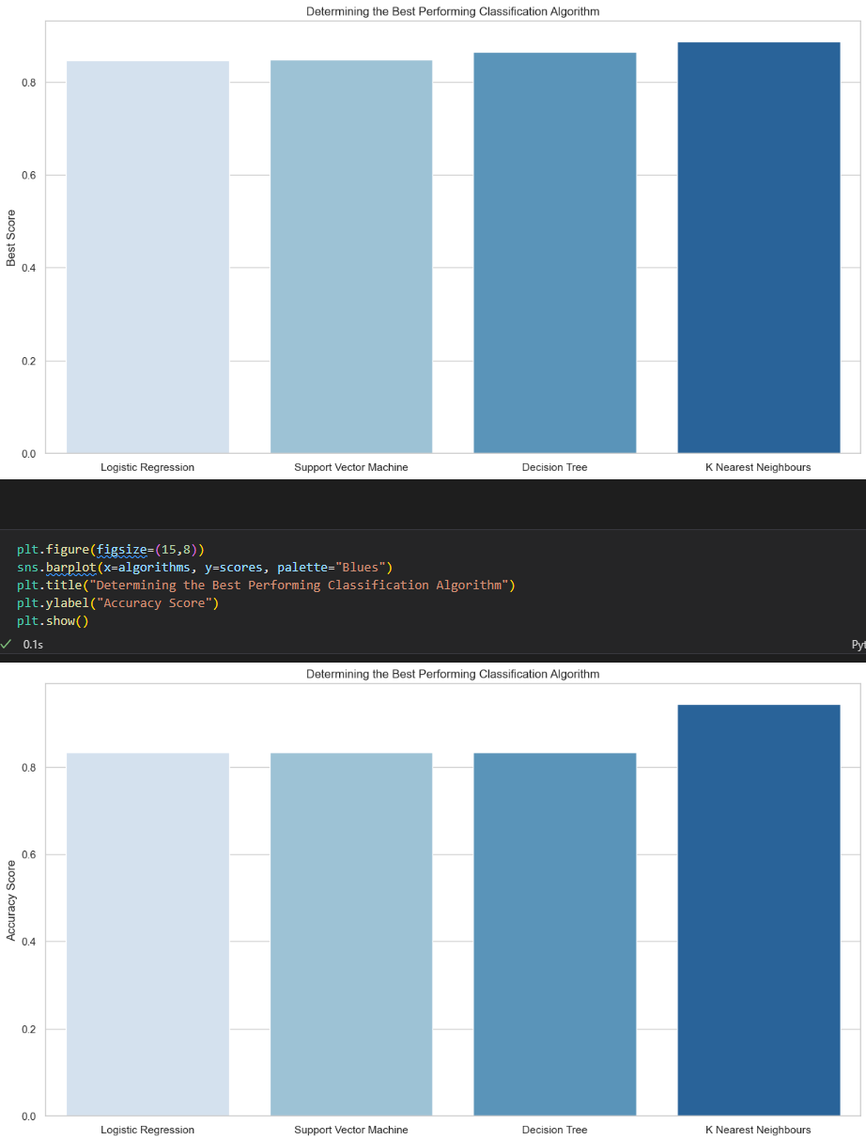
EXECUTIVE SUMMARY
Summary of Methodologies
The project follows these steps:
Data Collection
Data Wrangling
Exploratory Data Analysis
Interactive Visual Analytics
Predictive Analysis (Classification)
Summary of Results
This project produced the following:
Exploratory Data Analysis (EDA) Results
Geospatial Analytics
Interactive Dashboards
Predictive Analysis of Classification Models

Slide 4

INTRODUCTION
SpaceX launches Falcon 9 rockets with a lower cost per launch at about $62m as compared to other companies (typically about $165m). This can be credited to the fact that SpaceX can land and re-use the first stage of the rocket.
If predictions can be made about whether the first stage will land or not, then we can determine the cost of a launch. We can then use this information to assess if an alternate company should bid against SpaceX for a rocket launch.
The aim of this project is to successfully predict if the SpaceX Flacon 9 will land successfully.

Slide 5
METHODOLOGY SUMMARY
Data Collection
Using GET requests to the SpaceX REST API
Web Scraping
Data Wrangling
Using .fillna() method to remove NaN values
Using .value_counts() method to determine:
Number of launches on each site
Number of occurrences of each orbit
Number and occurrence of mission outcome per orbit type
Creating a landing outcome label that shows the following:
0 when the booster did not land successfully
1 when the booster landed successfully
Exploratory Data Analysis
Using SQL queries to manipulate and evaluate the SpaceX dataset
Using Pandas and Matplotlib to visualize relationships between variables and determine patterns
Interactive Visual Analytics
Geospatial analytics using Folium
Creating an interactive dashboard using Plotly Dash
Data Modeling and Evaluation
Using Scikit-Learn to:
Pre-process (standardize and normalize the data)
Split the data into training and testing data using .train_test_split()
Train different classification models
Find hyperparameters using .GridSearchCV()
Plotting confusion matrices for each classification model
Assessing the accuracy of each classification model

Slide 6
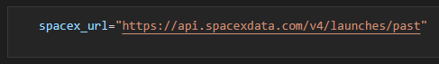

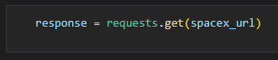
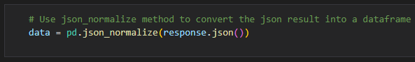
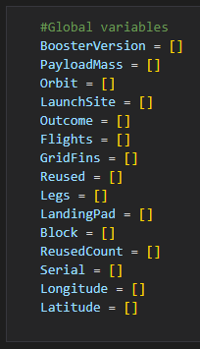
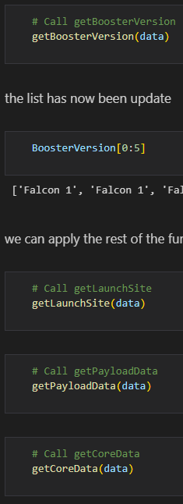
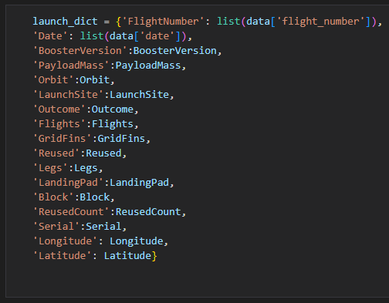


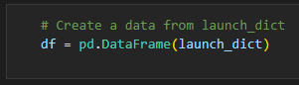
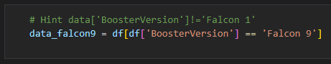

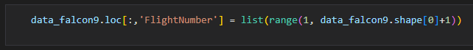
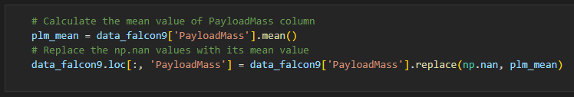
DATA COLLECTION: SPACEX REST API
Using the SpaceX API to retrieve data about various launches, this process includes gathering information on the type of rocket used, payload delivered, launch specification, landing specification, and landing outcome for each entry.
STEP 1:
Make a GET response to the SpaceX REST API
Convert it to a .json file then into a Pandas DataFrame
STEP 2:
Use custom logic to clean the data
Define lists for the data to be stored in
Call custom functions to retrieve data and fill the lists
Use list values as a dictionary and construct the dataset
STEP 3:
Create Pandas DataFrame from the constructed dictionary dataset
STEP 4:
Filter the DataFrame to only include Falcon 9 launches
Reset the FlightNumber column
Replace missing values of PayloadMass with mean PayloadMass

Slide 7
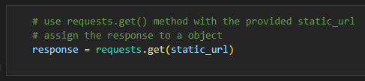
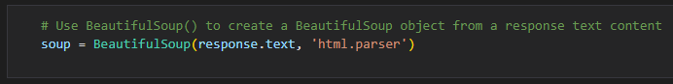
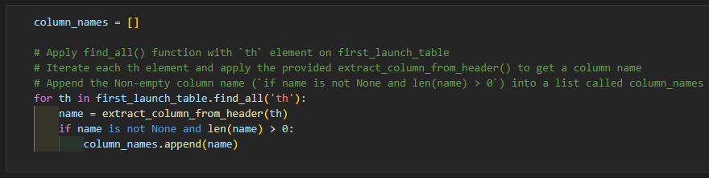
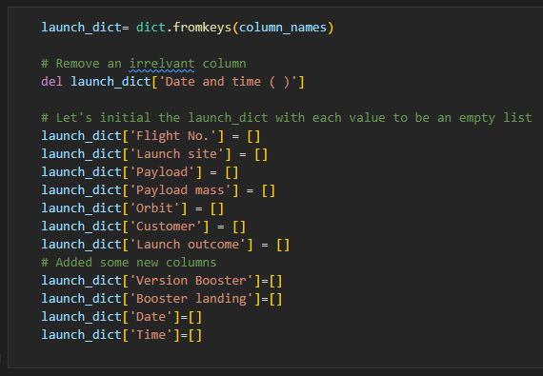

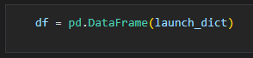
DATA COLLECTION: WEB SCRAPING
Web scraping done with BeautifulSoup to collect Falcon 9 historical launch records from a Wikipedia page titled Falcon 9 and Falcon Heavy launches.
STEP 1:
Request the HTML page from the static URL
STEP 2:
Create a BeautifulSoup object
Find all tables within the HTML page
STEP 3:
Collect all column header names from the tables found within the HTML page
STEP 4:
Use the column names as keys in a dictionary
Use custom functions and logic to parse all launch tables to fill dictionary values
STEP 5:
Convert the dictionary to Pandas DataFrame ready for export

Slide 8
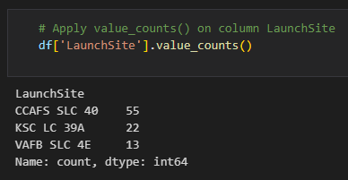
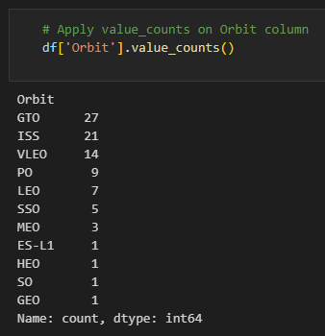
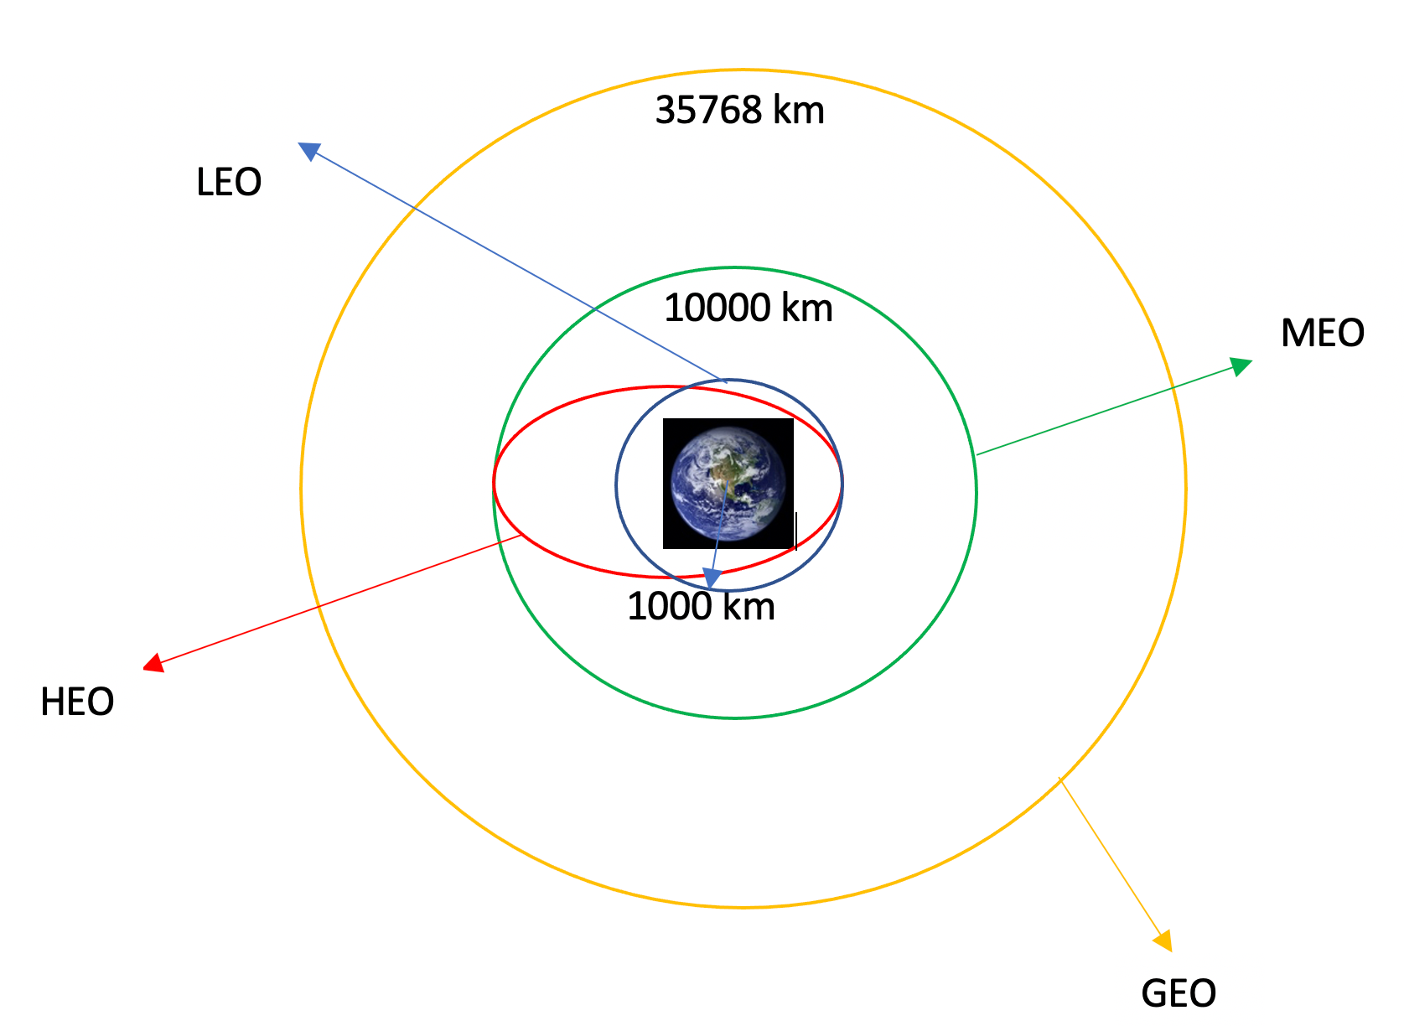
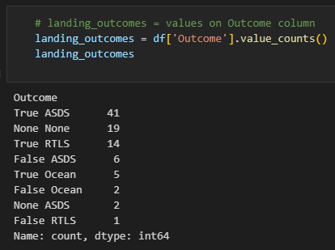
DATA WRANGLING USING PANDAS
The SpaceX dataset contains various launch facilities. We can identify the launch facilities in the LaunchSite column.
Each launch aims toward a dedicated orbit. The orbit types can be found in the Orbit column. The various orbit types are shown below:
Using the .value_counts() method, we can determine the following information:
Number of launches for each site
Number and occurrence of each orbit
Number and occurrence of landing outcome per orbit type

Slide 9
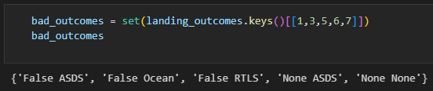
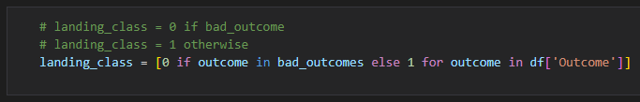
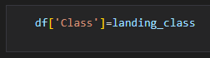
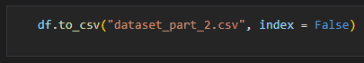
DATA WRANGLING USING PANDAS
The landing outcome is shown in the Outcome column:
True Ocean - the mission outcome was successfully landed to a specific region of the ocean.
False Ocean - the mission outcome was unsuccessfully landed to a specific region of the ocean.
True RTLS - the mission outcome was successfully landed to a ground pad.
False RTLS -the mission outcome was unsuccessfully landed to a ground pad.
True ASDS - the mission outcome was successfully landed to a drone ship.
False ASDS - the mission outcome was unsuccessfully landed to a drone ship.
None ASDS and None None - these represent a failure to land.
To determine whether a booster will successfully land, it is best to have a binary column (i.e., where the value is 1 or 0, representing the landing status).
The is done by:
Step 1: Defining a set of unsuccessful outcomes, bad_outcome.
Step 2: Creating a list, landing_class, where the element is 0 if the corresponding row in Outcome is in the set bad_outcome, otherwise, it’s 1.
Step 3: Create a Class column that contains the values from the list landing_class.
Step 4: Export the DataFrame as a .csv file.

Slide 10



EXPLORATORY DATA ANALYSIS (EDA) WITH VISUALIZATION
SCATTER PLOTS
Scatter plots were used to visualize the relationships between:
Flight Number x Launch Site
Payload x Launch Site
Orbit Type x Flight Number
Payload x Orbit Type
Scatter plots help visualize the relationships and correlations between two numeric variables
BAR CHARTS
A bar chart was used to visualize the relationship between:
Success Rate x Orbit Type
Bar charts are used to compare a numeric value to a categorical variable. They can also be used to compare multiple variables to each other.
LINE CHARTS
Line charts were used to produce and visualize the relationship between:
Success Rate x Year
Line charts contains multiple numerical values on both axes and are generally used for showing the change in a variable measured against itself.

Slide 11
EXPLORATORY DATA ANALYSIS (EDA) USING SQL
To gather some information about the dataset, some SQL queries were performed.
The SQL queries performed on the data set were used to:
1. Display the names of the unique launch sites in the space mission
2. Display 5 records where launch sites begin with the string 'CCA'
3. Display the total payload mass carried by boosters launched by NASA (CRS)
4. Display the average payload mass carried by booster version F9 v1.1
5. List the date when the first successful landing outcome on a ground pad was achieved
6. List the names of the boosters which had success on a drone ship and a payload mass between 4000 and 6000 kg
7. List the total number of successful and failed mission outcomes
8. List the names of the booster versions which have carried the maximum payload mass
9. List the failed landing outcomes on drone ships, their booster versions, and launch site names for 2015
10. Rank the count of landing outcomes (such as Failure (drone ship) or Success (ground pad)) between the date 2010-06-04 and 2017-03-20, in descending order

Slide 12
GEOSPATIAL ANALYSIS USING FOLIUM
The following steps were taken to visualize the launch data on an interactive map:
Mark all launch sites on a map
Initialize the map using a Folium Map object
Add a folium.Circle and folium.Marker for each launch site on the launch map
Mark the success/failed launches for each site on a map
As many launches have the same coordinates, it makes sense to cluster them together.
Before clustering them, assign a marker color of successful (class = 1) as green, and failed (class = 0) as red. To put the launches into clusters, for each launch, add a folium.Marker to the MarkerCluster() object.
Create an icon as a text label, assigning the icon_color as the marker_color determined previously.
Calculate the distances between a launch site to its proximities
To explore the proximities of launch sites, calculations of distances between points can be made using the Lat and Long values.
After marking a point using the Lat and Long values, create a folium.Marker object to show the distance.
To display the distance line between two points, draw a folium.PolyLine and add this to the map.

Slide 13
INTERACTIVE DASHBOARD USING PLOTLY DASH
The following plots were added to a Plotly Dash dashboard to have an interactive visualization of the data:
Pie chart (px.pie()) showing the total successful launches per site
This makes it clear to see which sites are most successful
The chart could also be filtered (using a dcc.Dropdown() object) to see the success/failure ratio for an individual site
Scatter graph (px.scatter()) to show the correlation between outcome (success or not) and payload mass (kg)
This could be filtered (using a RangeSlider() object) by ranges of payload masses
It could also be filtered by booster version

Slide 14



PREDICTIVE ANALYSIS USING CLASSIFICATION The following steps were taken to develop, evaluate, and find the best performing classification model:
MODEL DEVELOPMENT
To prepare the dataset for model development:
Load dataset
Perform necessary data transformations (standardize and pre-process)
Split data into training and test data sets, using train_test_split()
Decide which type of machine learning algorithms are most appropriate
For each chosen algorithm:
Create a GridSearchCV object and a dictionary of parameters
Fit the object to the parameters
Use the training data set to train the model
MODEL EVALUATION
For each chosen algorithm:
Using the output GridSearchCV object:
Check the tuned hyperparameters (best_params_)
Check the accuracy (score and best_score_)
Plot and examine the Confusion
Matrix
FINDING THE BEST MODEL
Review the accuracy scores for each algorithm
The model with the highest accuracy score is determined as the best performing model

Slide 15
RESULTS
EXPLORATORY ANALYSIS
INTERACTIVE ANALYTICS
PREDICTIVE ANALYSIS

Slide 16
EDA WITH VISUALIZATION

Slide 17
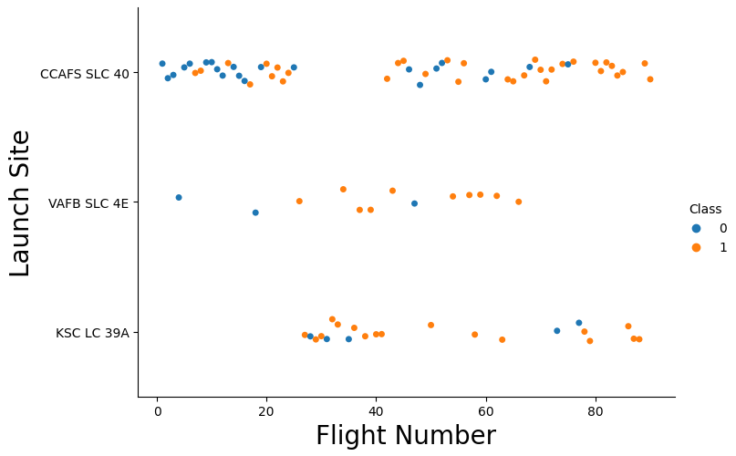
LAUNCH SITE VS. FLIGHT NUMBER
The scatter plot of Launch Site vs. Flight Number shows that:
As the number of flights increases, the rate of success at a launch site increases.
Most of the early flights (flight numbers <30) were launched from CCAFS SLC 40, and were generally unsuccessful.
The flights from VAFB SLC 4E also show this trend, that earlier flights were less successful.
No early flights were launched from KSC LC 39A, so the launches from this site are more successful.
Above a flight number of around 30, there are significantly more successful landings (Class = 1).

Slide 18
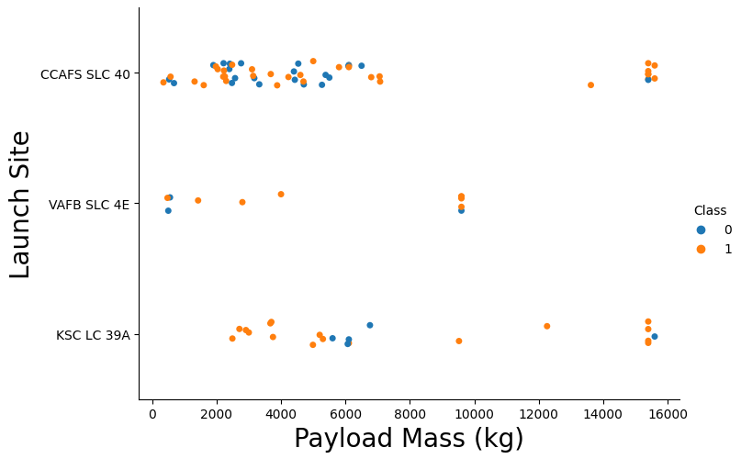
LAUNCH SITE VS. PAYLOAD MASS
The scatter plot of Launch Site vs. Payload Mass shows that:
Above a payload mass of around 7000 kg, there are very few unsuccessful landings,
but there is also far less data for these heavier launches.
There is no clear correlation between payload mass and success rate for a given launch site.
All sites launched a variety of payload masses, with most of the launches from CCAFS SLC 40 being comparatively lighter payloads (with some outliers).

Slide 19

SUCCESS RATE VS. ORBIT TYPE
The bar chart of Success Rate vs. Orbit Type shows that the following orbits have the highest (100%) success rate:
ES-L1 (Earth-Sun First Lagrangian Point)
GEO (Geostationary Orbit)
HEO (High Earth Orbit)
SSO (Sun-synchronous Orbit)
The orbit with the lowest (0%) success rate is:
SO (Heliocentric Orbit)

Slide 20
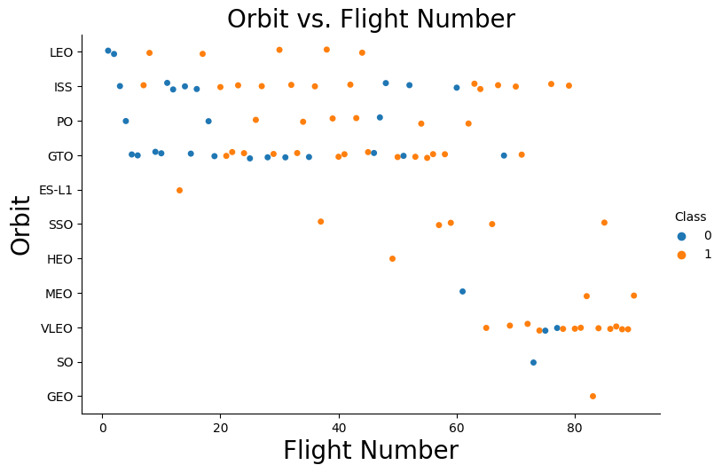
ORBIT TYPE VS. FLIGHT NUMBER
This scatter plot of Orbit Type vs. Flight number shows a few useful things that the previous plots did not, such as:
The 100% success rate of GEO, HEO, and ES-L1 orbits can be explained by only having 1 flight into the respective orbits.
The 100% success rate in SSO is more impressive, with 5 successful flights.
There is little relationship between Flight Number and Success Rate for GTO.
Generally, as Flight Number increases, the success rate increases. This is most extreme for LEO, where unsuccessful landings only occurred for the low flight numbers (early launches).

Slide 21
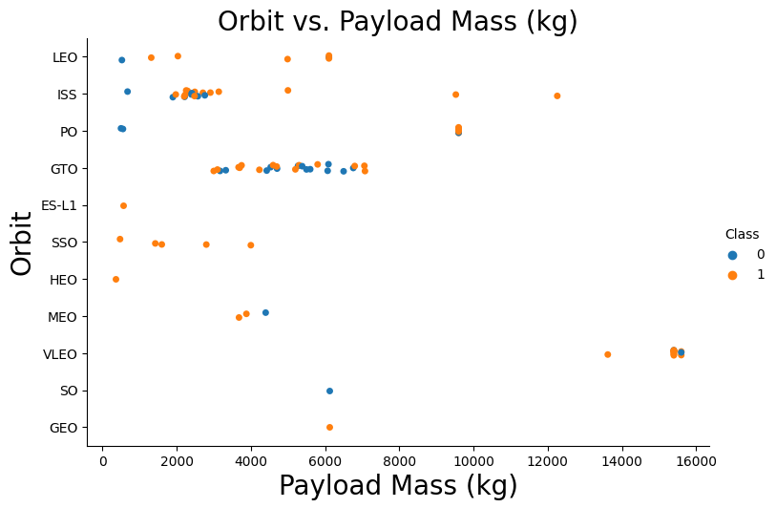
ORBIT TYPE VS. PAYLOAD MASS
This scatter plot of Orbit Type vs. Payload Mass shows that:
The following orbit types have more success with heavy payloads:
PO
ISS
LEO
For GTO, the relationship between payload mass and success rate is unclear.
VLEO (Very Low Earth Orbit) launches are associated with heavier payloads, which makes intuitive sense.

Slide 22
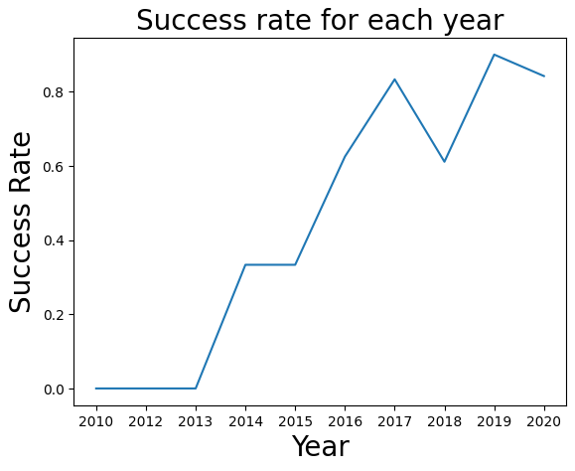
LAUNCH SUCCESS YEARLY TREND
The line chart of yearly average success rate shows that:
Between 2010 and 2013, all landings were unsuccessful (as the success rate is 0).
After 2013, the success rate generally increased, despite small dips in 2018 and 2020.
After 2016, there was always a greater than 50% chance of success.

Slide 23


EDA USING SQL

Slide 24
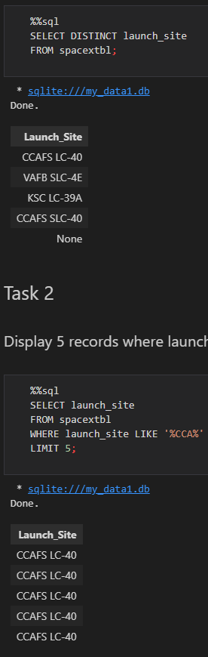
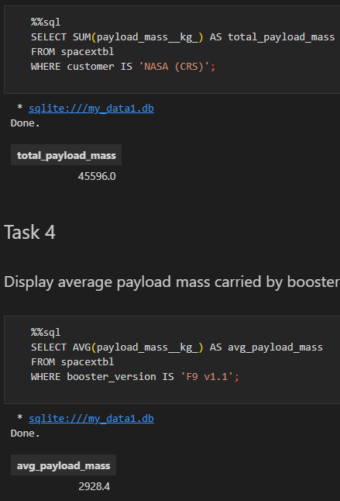
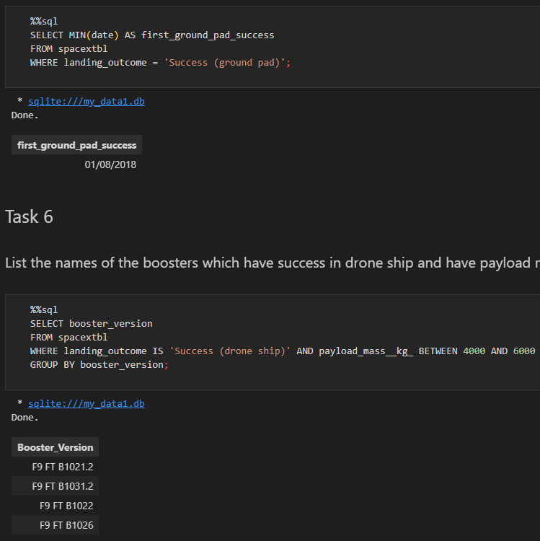

OVERVIEW OF THE DATASET USING SQL
Display the names of the unique launch sites in the space mission
Display 5 records where launch sites begin with the string 'CCA'
Display the total payload mass carried by boosters launched by NASA (CRS)
Display average payload mass carried by booster version F9 v1.1
List the date when the first successful landing outcome in ground pad was achieved.
List the names of the boosters which have success in drone ship and have payload mass greater than 4000 but less than 6000

Slide 25
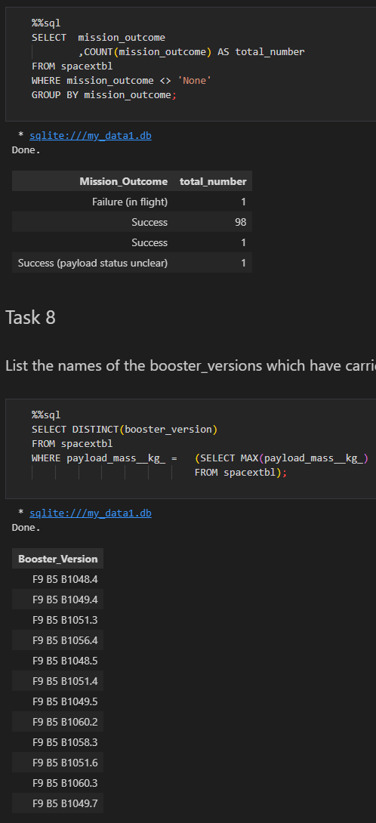
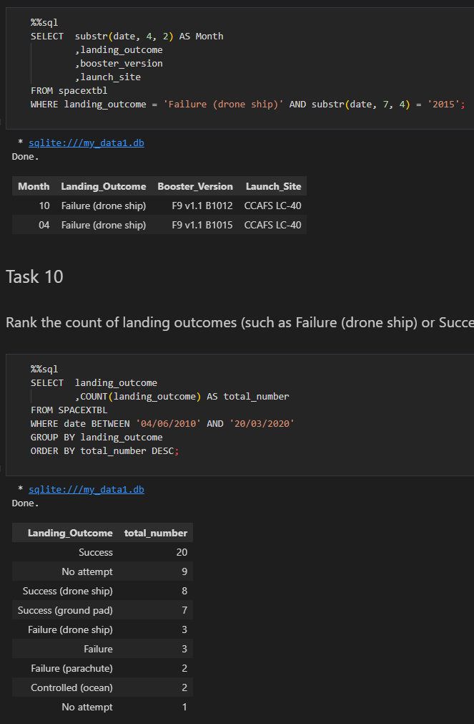
OVERVIEW OF THE DATASET USING SQL
List the total number of successful and failure mission outcomes
List the names of the booster_versions which have carried the maximum payload mass using a subquery
List the records which will display the month names, failure landing_outcomes in drone ship ,booster versions, launch_site for the months in year 2015.
Rank the count of landing outcomes (such as Failure (drone ship) or Success (ground pad)) between the date 2010-06-04 and 2017-03-20, in descending order.

Slide 26


LAUNCH SITES PROXIMITY ANALYSIS: FOLIUM INTERACTIVE MAP

Slide 27
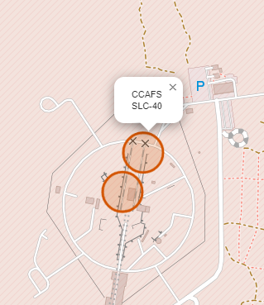

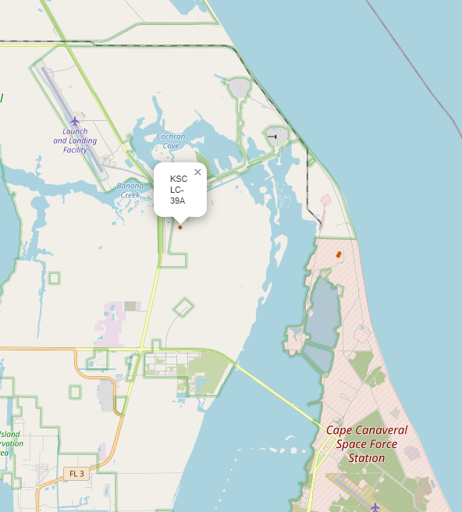
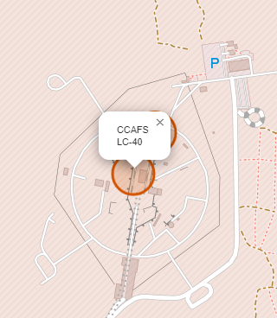
ALL LAUNCH SITES ON A MAP
All SpaceX launch sites are on the coasts of the United States, specifically Florida and California.

Slide 28
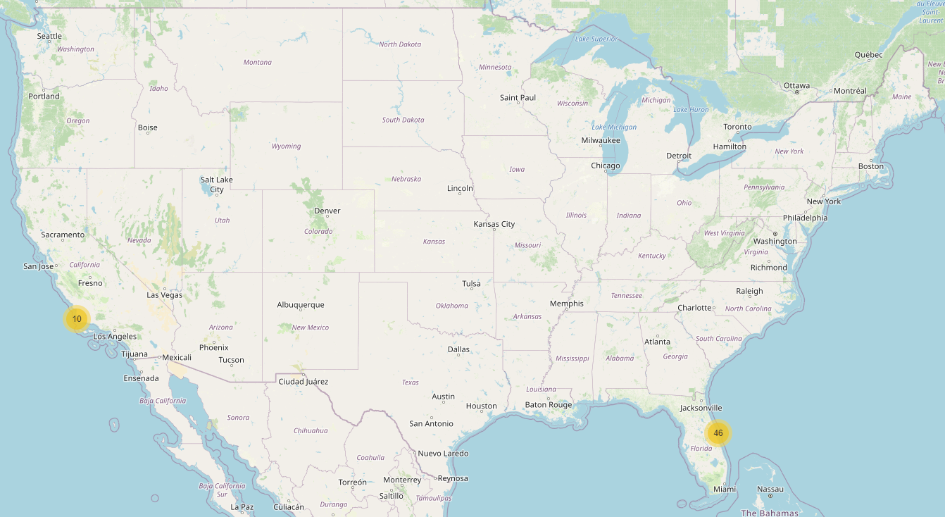
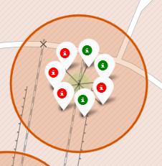
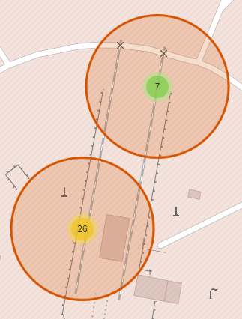
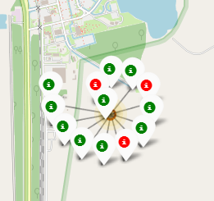
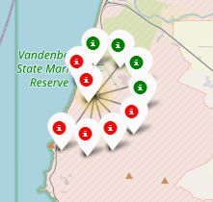
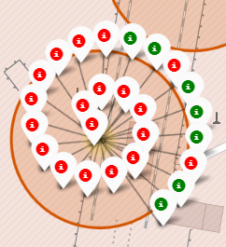
SUCCESSFUL AND FAILED LAUNCHES FOR EACH SITE
Launches have been grouped into clusters, where green icons are successful launches, and red icons are failed launches.
CCAFS SLC-40
=
CCAFS LC-40
VAFB SLC-4E
KSC LC-39A

Slide 29
PROXIMITY OF LAUNCH SITES TO POINTS OF INTEREST
Using CCAFS SLC-40 as an example site, the following questions can be asked to understand more about the placement of launch sites:
Are launch sites in close proximity to railways?
Yes, the coastline is only 0.87 km due East.
Are launch sites in close proximity to highways?
Yes, the nearest highway is only 0.59 km away.
Are launch sites in close proximity to railways?
Yes, the nearest railway is only 1.29 km away.
Do launch sites keep a certain distance away from cities?
Yes, the nearest city is 51.74 km away.

Slide 30


INTERACTIVE DASHBOARD ANALYSIS: PLOTLY DASH

Slide 31
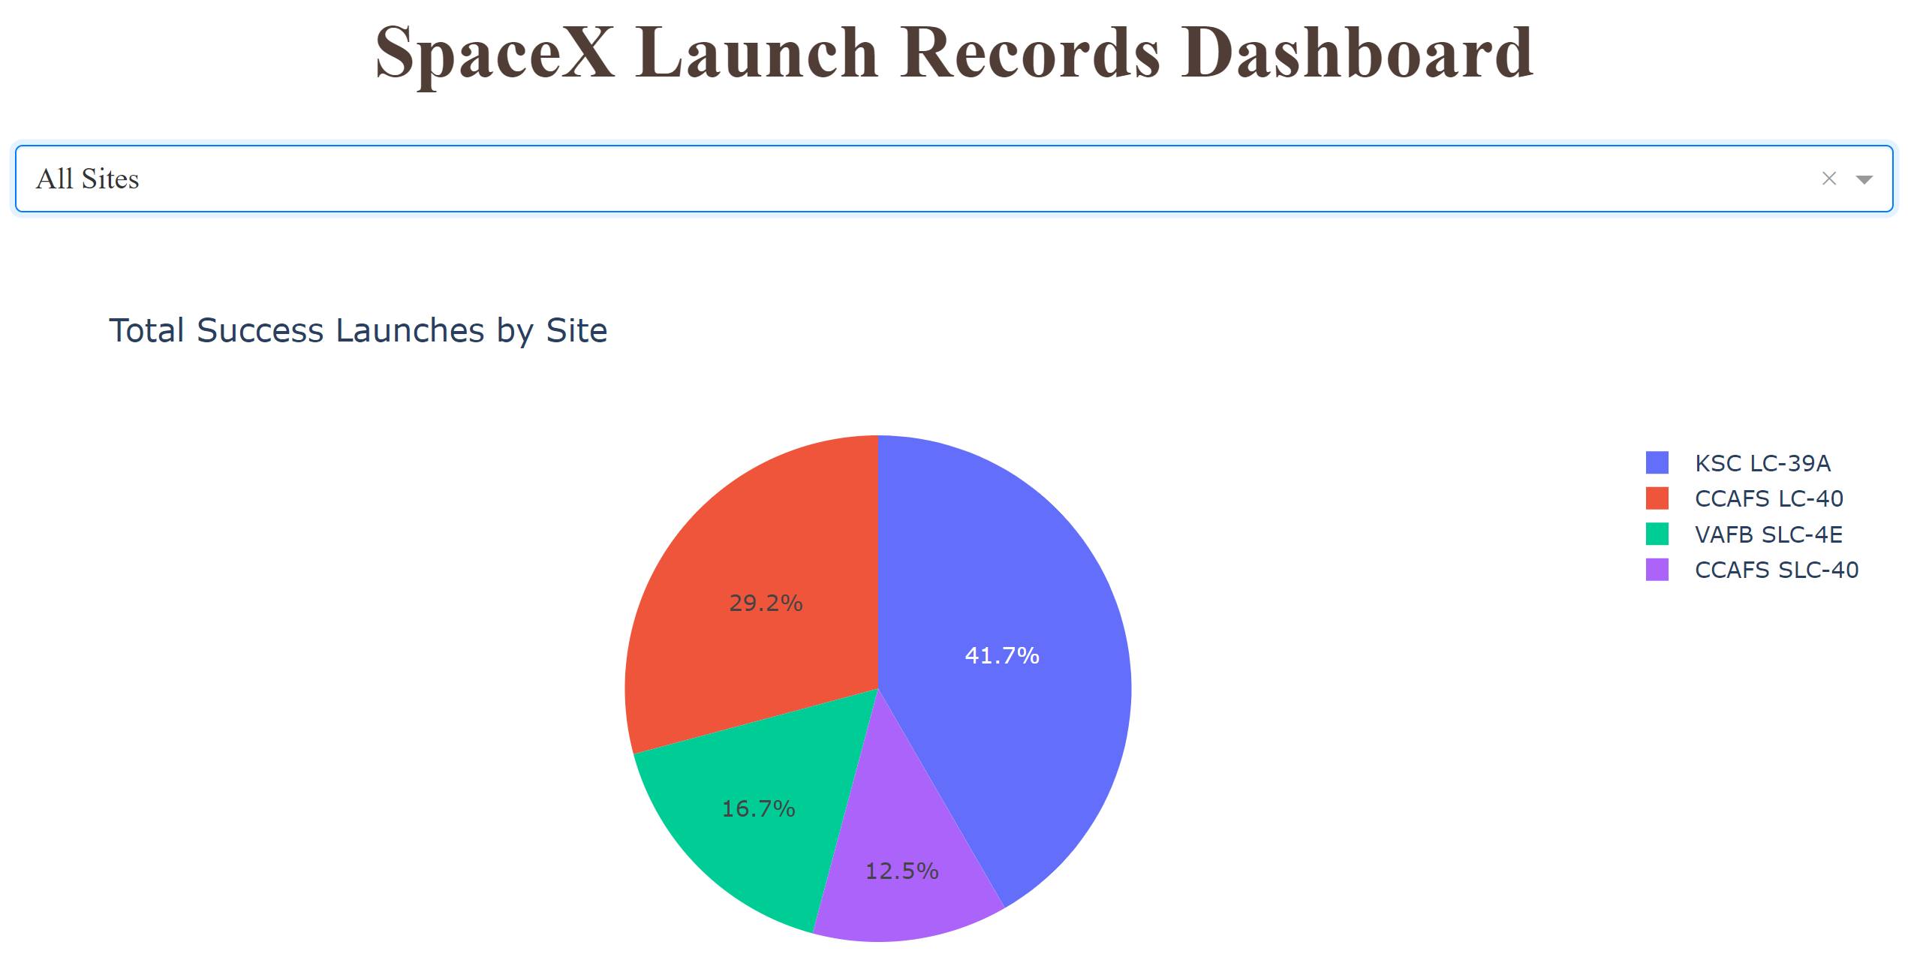
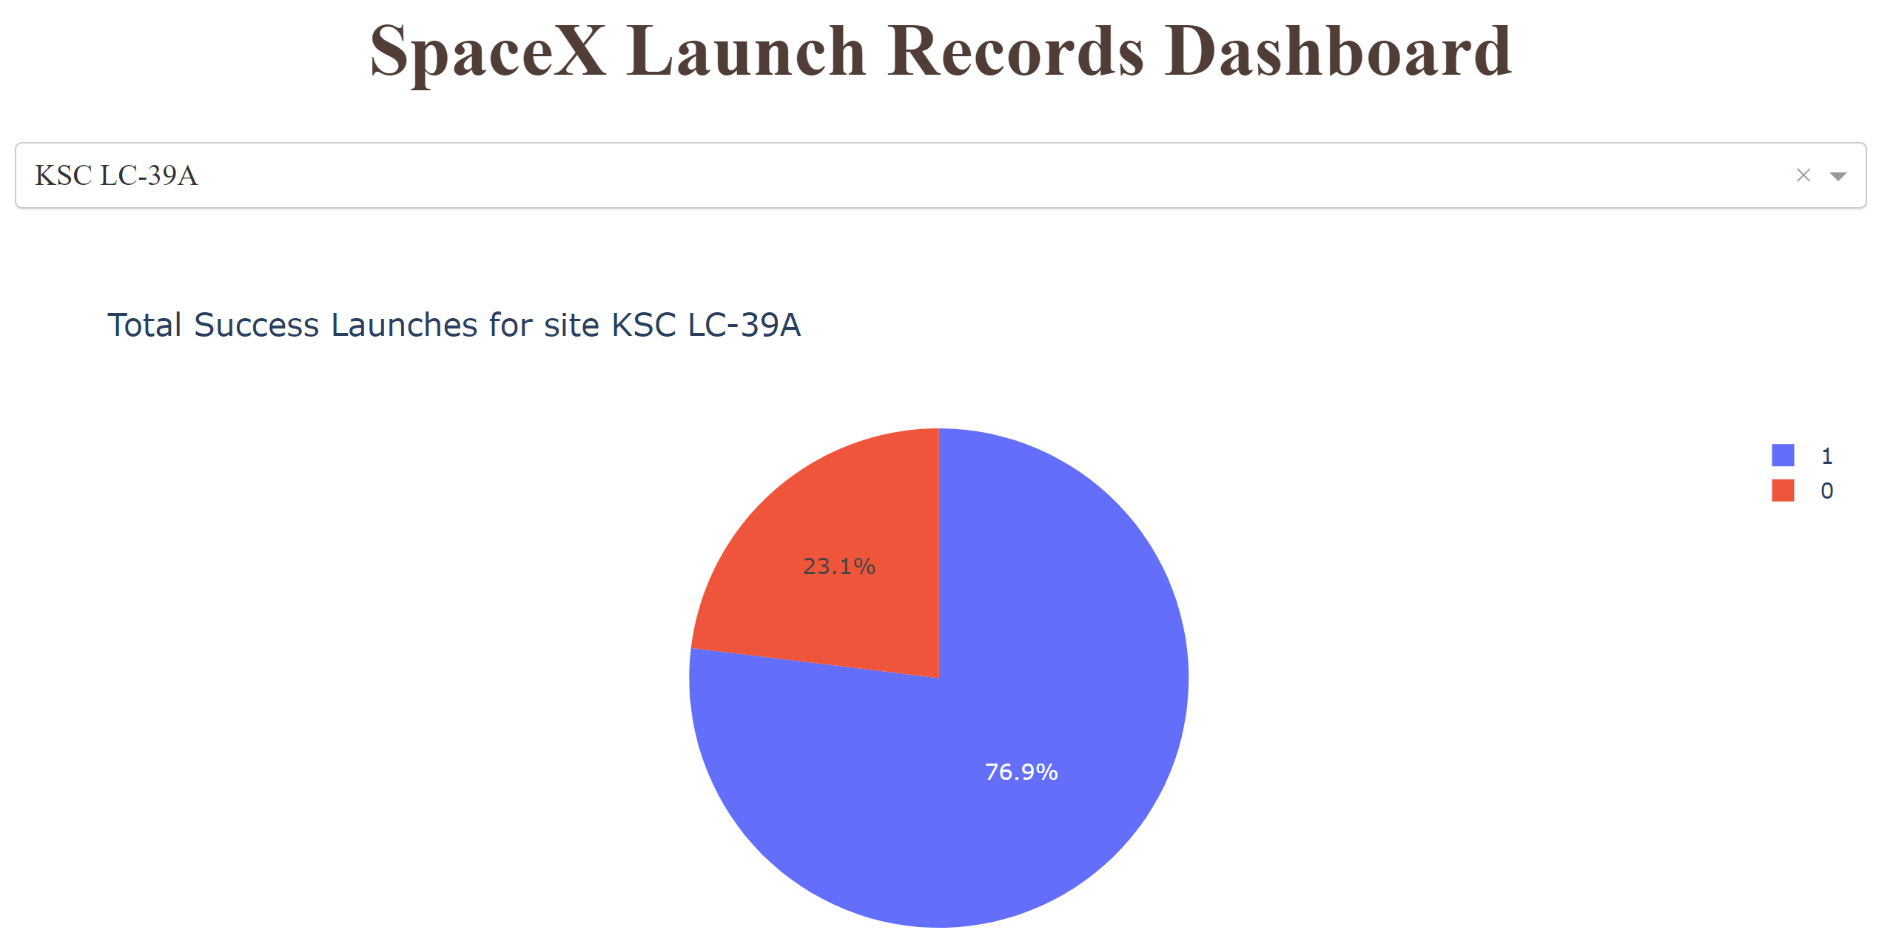
LAUNCH SITE SUCCESS RATES
The launch site KSC LC-39 A had the most successful launches, with 41.7% of the total successful launches.
The launch site KSC LC-39 A also had the highest rate of successful launches, with a 76.9% success rate.

Slide 32
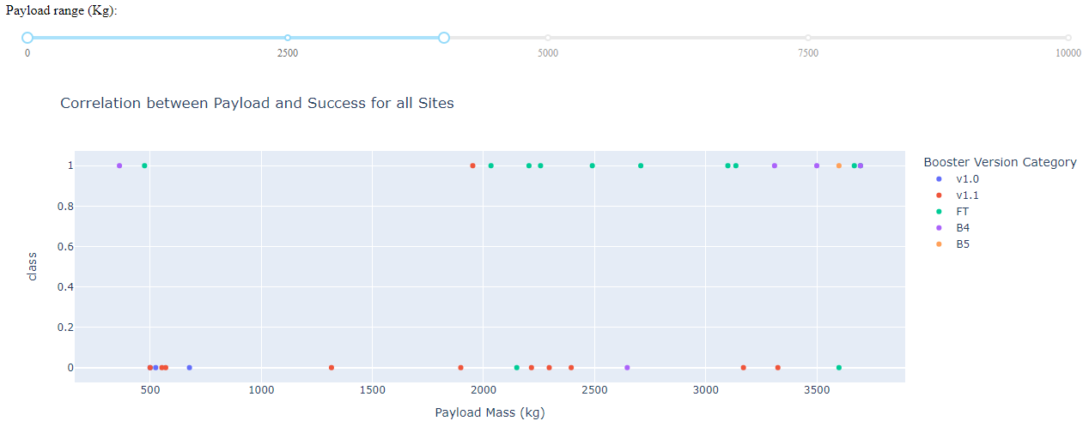
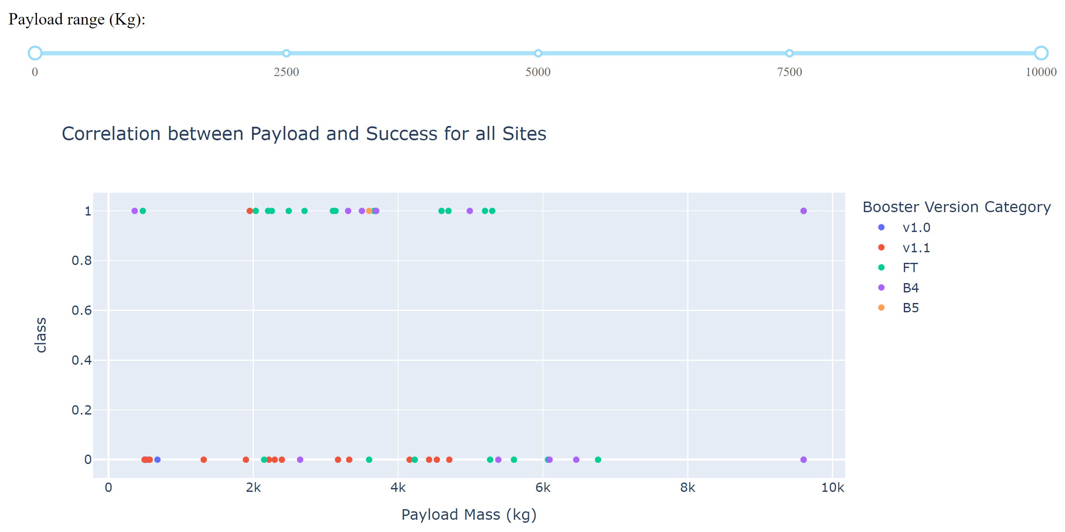

SCATTER PLOT (ALL SITES): LAUNCH OUTCOME VS. PAYLOAD MASS
Plotting the launch outcome vs. payload mass for all sites shows a gap around 4000 kg, so it makes sense to split the data into two ranges:
0 – 4000 kg (low payload mass)
4001 – 10000 kg (high payload mass)
From these two plots, it can be observed that the success for higher payload mass is lower than that for lower payload mass.
It is also worth noting that some booster types (v 1.0 and B5) have not been launched with high payload mass.

Slide 33


PREDICTIVE ANALYSIS USING CLASSIFICATION

Slide 34

CLASSIFICATION ACCURACY
Plotting the Accuracy Score and Best Score for each classification algorithm produces the following result:
The K-Nearest Neighbors model has the highest classification accuracy
The Accuracy Score is 94.44%
The Best Score is 88.75%

Slide 35

CONFUSION MATRIX
As shown previously, best performing classification model is the K-Nearest Neighbors model, with an accuracy of 94.44%.
This is explained by the confusion matrix, which shows only 1 out of 18 total results classified incorrectly (a false positive, shown in the top-right corner).
The other 17 results are correctly classified (5 did not land, 12 did land).

Slide 36


CONCLUSIONS
As the number of flights increases, the rate of success at a launch site increases, with most early flights being unsuccessful (i.e. with more experience, the success rate increases.)
Between 2010 and 2013, all landings were unsuccessful (as the success rate is 0).
After 2013, the success rate generally increased, despite small dips in 2018 and 2020.
After 2016, there was always a greater than 50% chance of success.
Orbit types ES-L1, GEO, HEO, and SSO, have the highest (100%) success rate.
The 100% success rate of GEO, HEO, and ES-L1 orbits can be explained by only having 1 flight into the respective orbits.
The 100% success rate in SSO is more impressive, with 5 successful flights.
The orbit types PO, ISS, and LEO, have more success with heavy payloads:
VLEO (Very Low Earth Orbit) launches are associated with heavier payloads, which makes intuitive sense.
The launch site KSC LC-39 A had the most successful launches, with 41.7% of the total successful launches, and also the highest rate of successful launches, with a 76.9% success rate.
The success for massive payloads (over 4000 kg) is lower than that for low payloads (this means a smaller payload translates to a higher success rate).
The best performing classification model is the K-Nearest Neighbors model, with an accuracy of 94.44%.

